Slide 1


Annotation Procedure
Diego Bárbulo Barrios (MFN)
Contact: diego.barbulobarrios@wur.nl

Slide 2
Preprocessing: video to frames
Open Linux command line
Install ffmpeg -> sudo apt install ffmpeg
Navigate to directory containing the video -> cd …
Enter the following command:
ffmpeg -i xxxx.mp4 -filter:v "crop=1296:972" -r 25 -start_number 0 -f image2 000%3d.png
Filename
Crop frames (optional)
Frame -rate
Start number of frames (optional)
Output format of frames (optional)

Slide 3
Annotation Tools
On our study, 3 annotation tools were tested for instance segmentation:
CVAT
Supervise.ly
Hasty.ai
CVAT was chosen among the three due to the time-saving benefits provided by its interpolation feature, which allows the annotator(s) to skip most of the frames when annotating manually.

Slide 4
Computer Vision Annotation Tool (CVAT)
Online (demo) and offline versions.
Online (cvat.org)
Max. 500 MB
Max. 10 tasks per user
Multiple annotators at once
Offline
Run in a docker container
Higher storage capacity
One annotator

Slide 5
Setting up CVAT
Online demo -> go to cvat.org and create an account.
Offline version -> In the CVAT GitHub repository, go to “Installation guide” in the documentation. There, follow the specific steps for installing on one of the compatible operating systems: Ubuntu 18.04 (only compatible Linux distro and version), MacOS or Windows 10.
You will have to install docker first, as CVAT is run in one of its containers. Commands for installing the desktop version of docker are provided in CVAT´s installation guide, but it can also be installed from the official page.

Slide 6
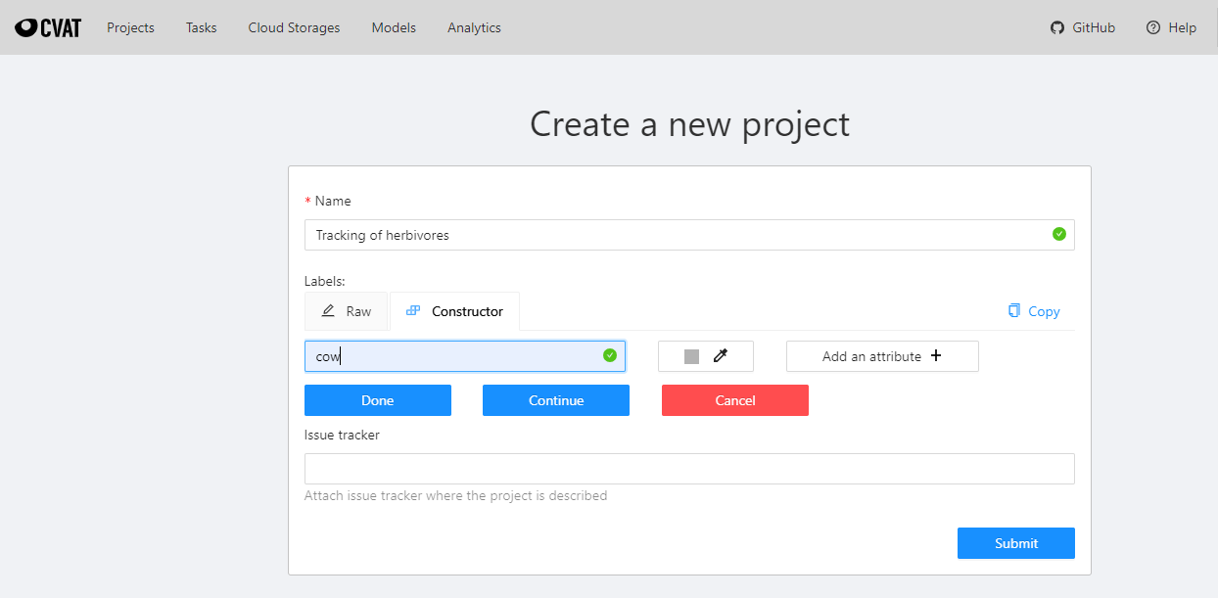
Step 1 in CVAT
Create a project and add the labels you are going to need

Slide 7
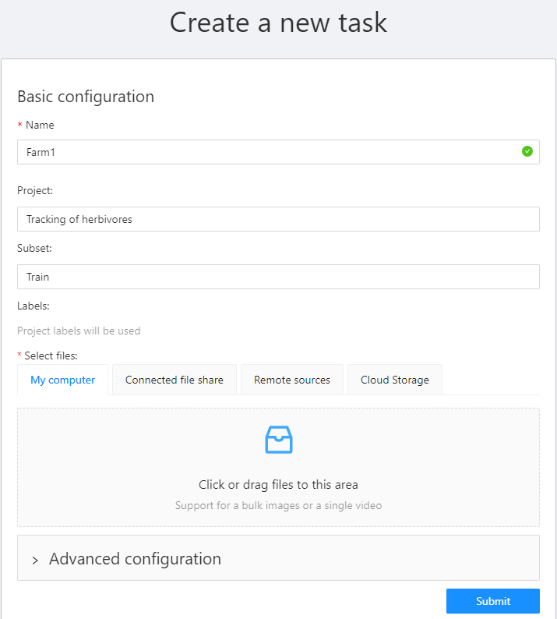
Step 2 in CVAT
Create annotation tasks (one per video sequence) within the project -> do this by pressing the “Create new task” button on the main page.
When annotating small objects, it is preferable to increase the image quality -> do this by unfolding the “Advanced configuration” option and increasing the image quality to 100.
Finally, upload the images and press “Submit”. It may take some time for all images to be uploaded to the server.

Slide 8
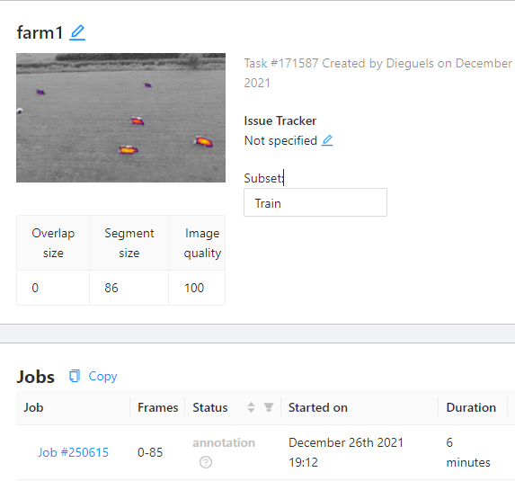
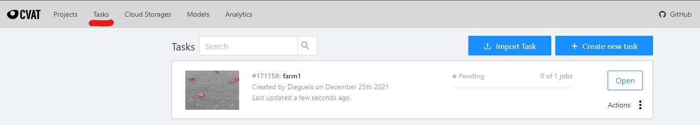
Step 3 in CVAT
Once uploaded, go back to Tasks and open it.
Within the task, open the Job #xxxx

Slide 9
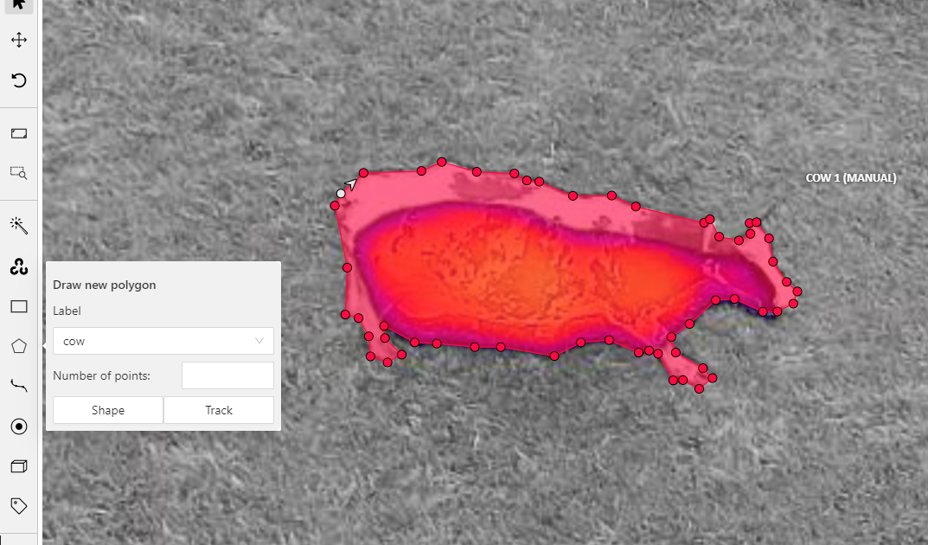
Annotation
For creating segmentation masks, select “Draw new polygon” from the left vertical bar, and choose:
“Shape” for semantic segmentation (identities are not assigned to masks, so the masks need to be redrawn on each frame)
“Track” for instance segmentation (masks only need to be drawn once for each animal). Finish a track by using the shortcut ‘n’.

Slide 10
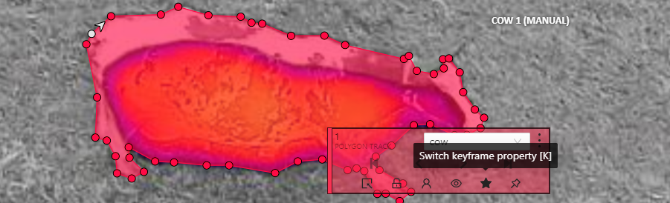
Annotation
The interpolation feature of CVAT automatically adjusts masks in unlabeled frames if they are located between labeled frames. Even though a human-in-the-Loop is needed to readjust some annotations, the interpolation feature saves annotators a significant amount of time.
The star shown in the image above marks the masks that CVAT uses as a reference for interpolation. For example, if the star is selected for one cow´s masks in frames 0 and 9. interpolation will be conducted on the frames in-between.

Slide 11
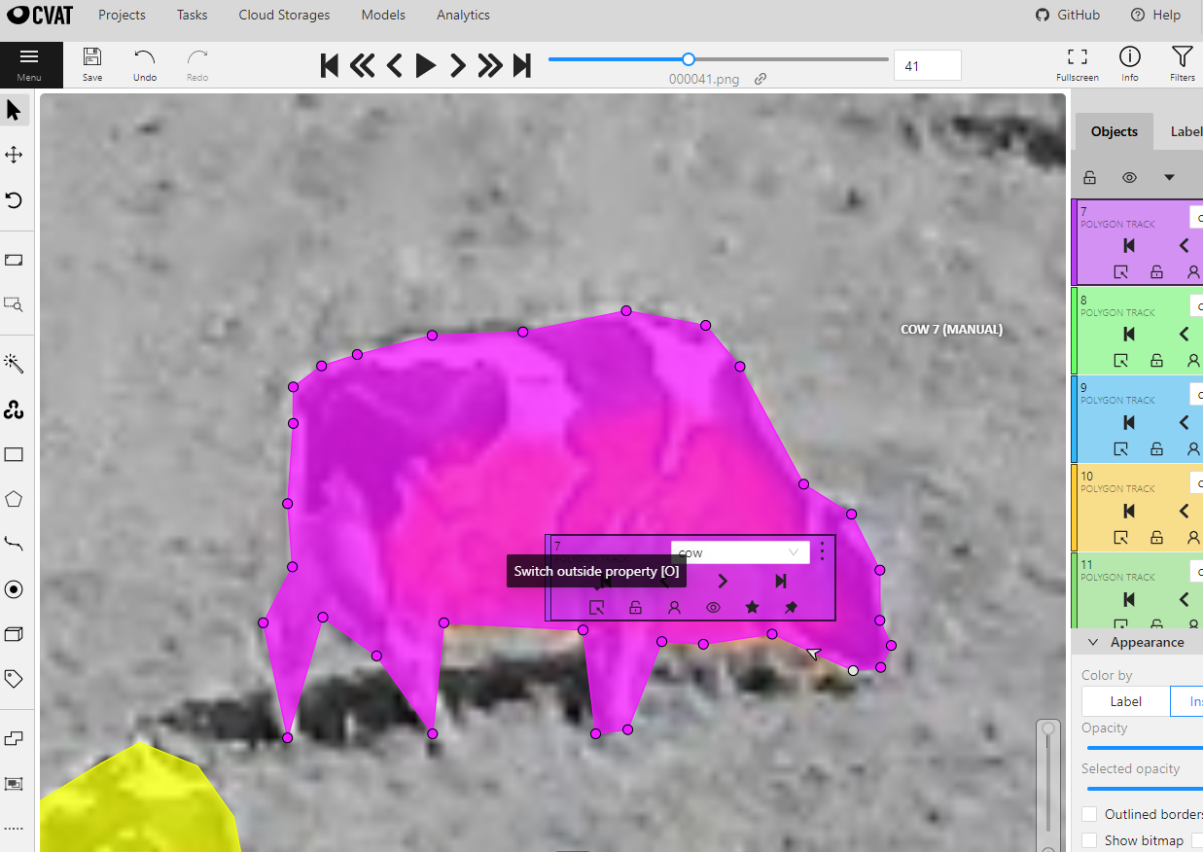
Annotation
Targets often disappear (move outside the frame or are occluded) at some point during the recording.
When this happens, the annotator must click on “switch outside property” on the target´s mask. This option will hide the mask from that frame onward, but it will not erase it in previous frames. DO NOT SELECT “REMOVE”, as this will delete the mask in previous frames too (i.e., all masks associated to the target´s identity will be removed).

Slide 12
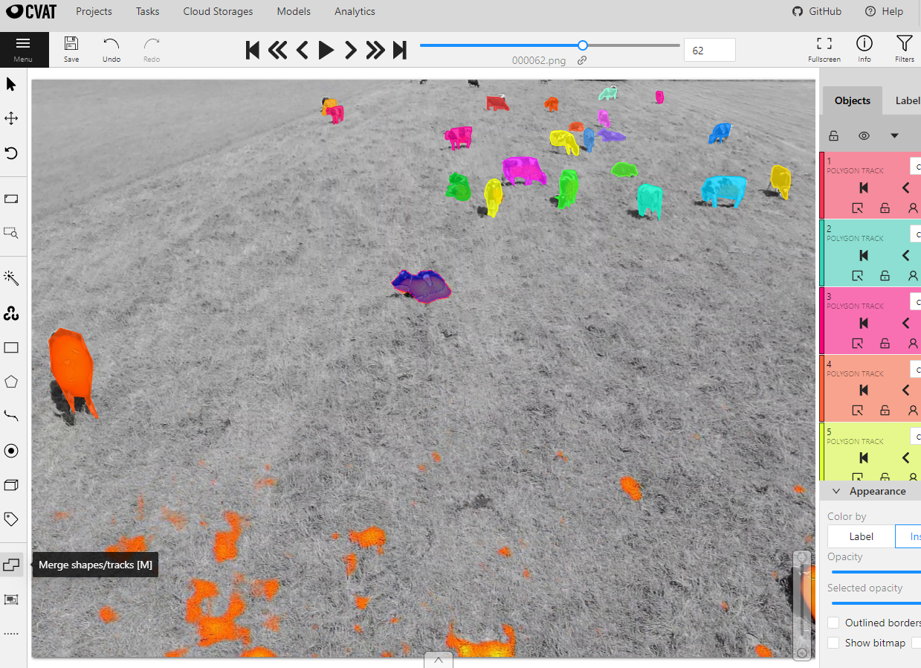
Annotation
Targets sometimes reappear in the recording. On these occasions, the annotator needs to redraw the mask when the target is spotted again and merge the new track with the old one via the “Merge shapes/tracks” option (located on the left-side vertical options bar).
Procedure: click on the merge option, select the last visible mask of the old track, select the first mask of the new track, and click on the merge option again. Both tracks are now linked to the same identity.

Slide 13
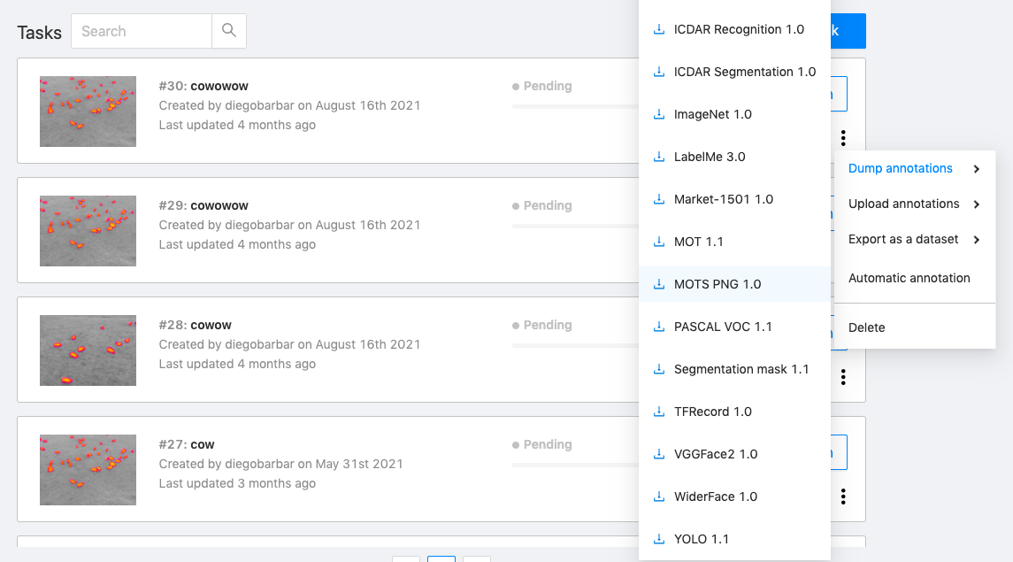
Dump annotations
In order to obtain the instances (i.e., annotations´ data), there are two options in the “Tasks” menu:
Select “export task dataset” to download the images and the annotations.
Select “dump annotations” to download only the annotations.
For training an instance segmentation algorithm, choose the export format MOTS PNG 1.0

Slide 14
Automatic annotation - CVAT
Data can be automatically annotated with models trained on Onepanel´s platform and GPUs. This process is also called pre-annotation, as a Human-in-the-Loop approach is needed to correct the models´ mistakes. However, avoiding the annotation of images from scratch saves a lot of time.
Automatic annotation can be done both for object detection (i.e., using bounding boxes) and segmentation (i.e., using polygon masks) tasks.
Instructions by Onepanel can be found on this link.
Keep in mind that automatic annotation is not free

Slide 15
Automatic annotation - CVAT
Firs, you will need to create a Kubernetes cluster on a paid-account of a cloud provider (i.e., Azure AKS, Amazon EKS or Google Cloud GKE).
Secondly, you will have to install Onepanel and deploy it to your cluster.
Thirdly, you can start with the annotation on your Workspace. After annotating the amount of data that you see fit, you can train one of the models provided by Onepanel on your annotations.
Finally, you can automatically pre-annotate the remaining data with your newly trained model.
For segmentation tasks, Onepanel provides Mask R-CNN.

Slide 16
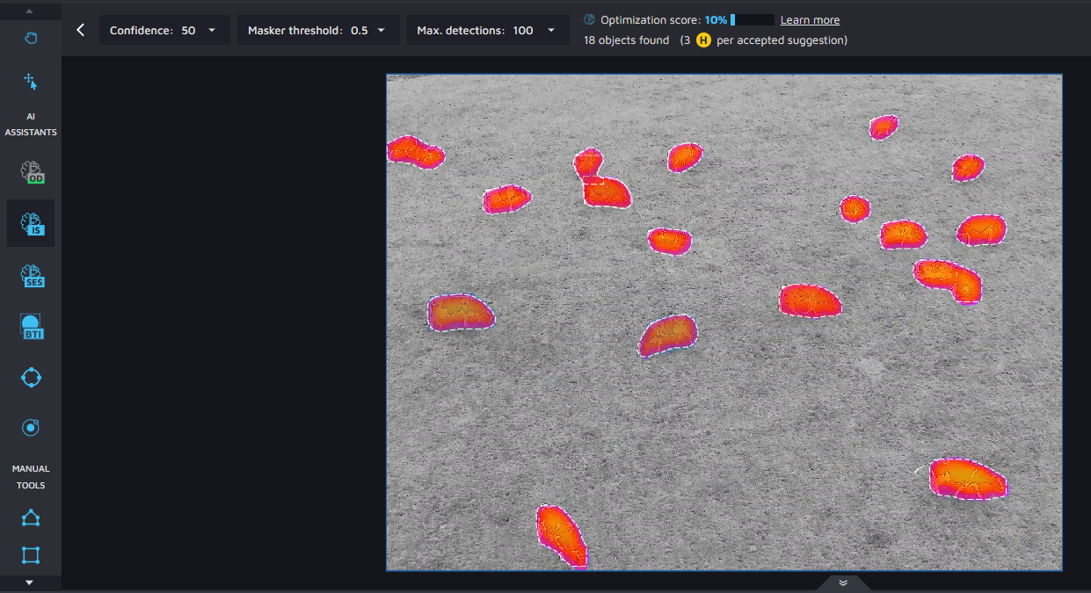
Automatic annotation – Hasty.ai
AI assistants are provided for semi-automatic and automatic annotation.
Semi-automatic annotation tools (DEXTR and Atom) can be used from the start of the annotation procedure.
Automatic annotation models are trained by the platform while manual/semi-automatic annotation is being conducted. They cover object detection, semantic segmentation and instance segmentation. When they are ready to be used, you will receive a notification. The free version of the platform limits the use of these models.

Slide 17
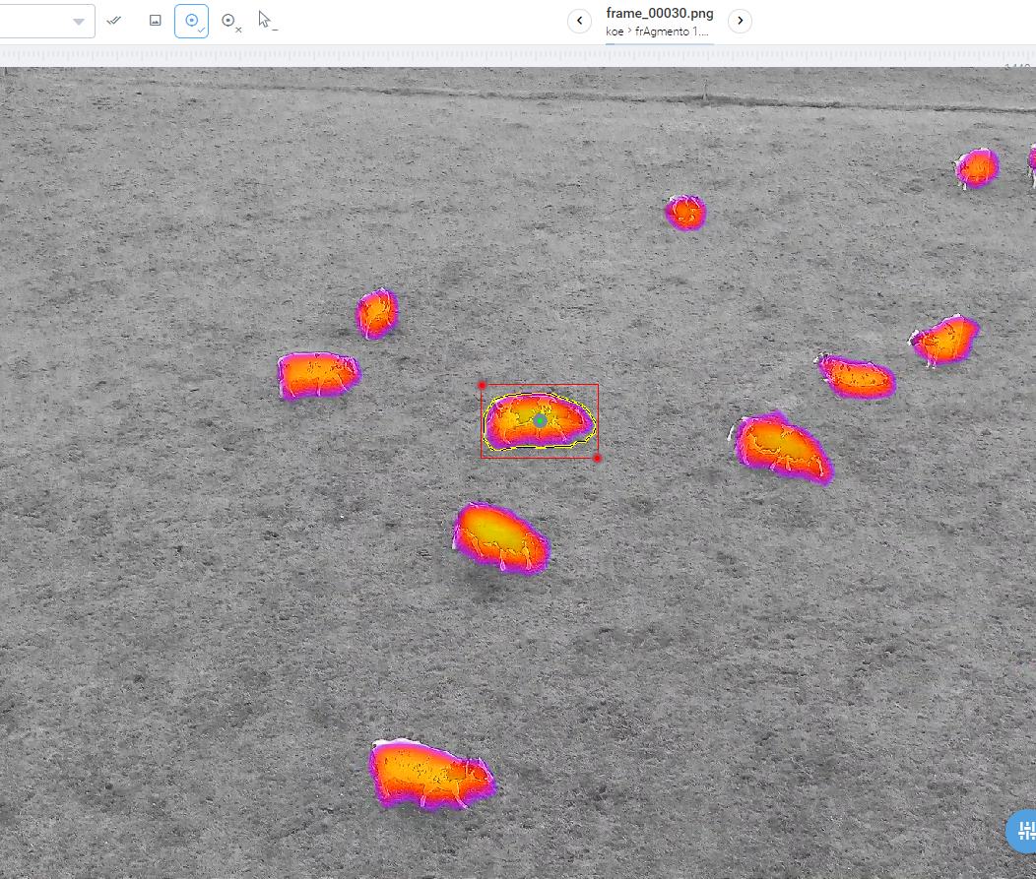
Automatic annotation – Supervise.ly
Provides both semi-automatic and automatic annotation.
There is a daily limit (1000 uses), in the free version, on the use of the semi-automatic annotation Smart Tool.
Automatic annotation (instructions):
As with CVAT and Hasty.ai, Supervise.ly offers a Human-in-the-loop approach to annotate faster.
Connect your PC via a Supervisely Agent (task manager available as a Docker image) to the Supervisely API to run the models available in the platform on your PC.
Requirements: Linux OS, Docker, NVIDIA GPU, CUDA 9.0, NVIDIA- Docker.
I have not tried this platform´s automatic annotation due to time-constraints; I am not sure whether the API can be used without a paying subscription.

